Slide 1

Automatic Melody Generator
- Musier -
2018.4.25 Pre-final Presentation
Team#:
Zhang Ruoqing 115010096
Li Kengjie 115010177
Ye Shuqian 115010269
Mo Fan 115010204
Wang Junce 115010231

Slide 2
Outline
Goal & SE Cycle Life
01
Individual Contribution
02
Demonstration
03
Problem & Solutions
04
Next 2 Weeks Plan
05

Slide 3

Pale words.
Let’s enjoy the music demo.
01
02
03
04
05

Slide 4
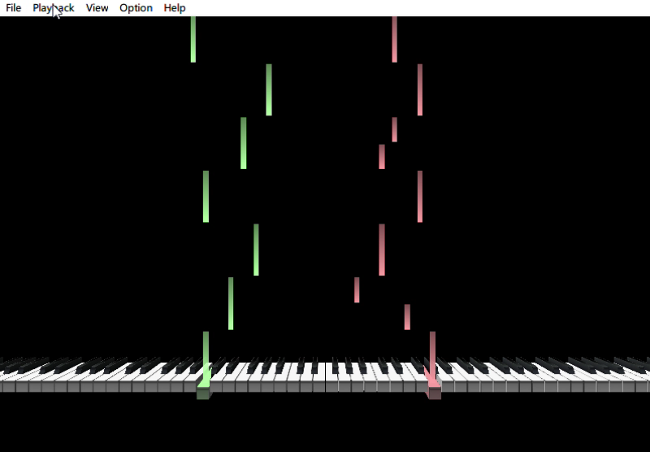
Example 1
01
02
03
04
05

Slide 5
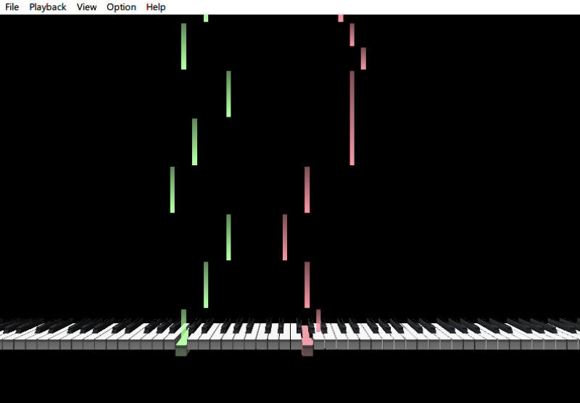
Example 2
01
02
03
04
05

Slide 6
01
Goal &
SE Cycle Life

Slide 7
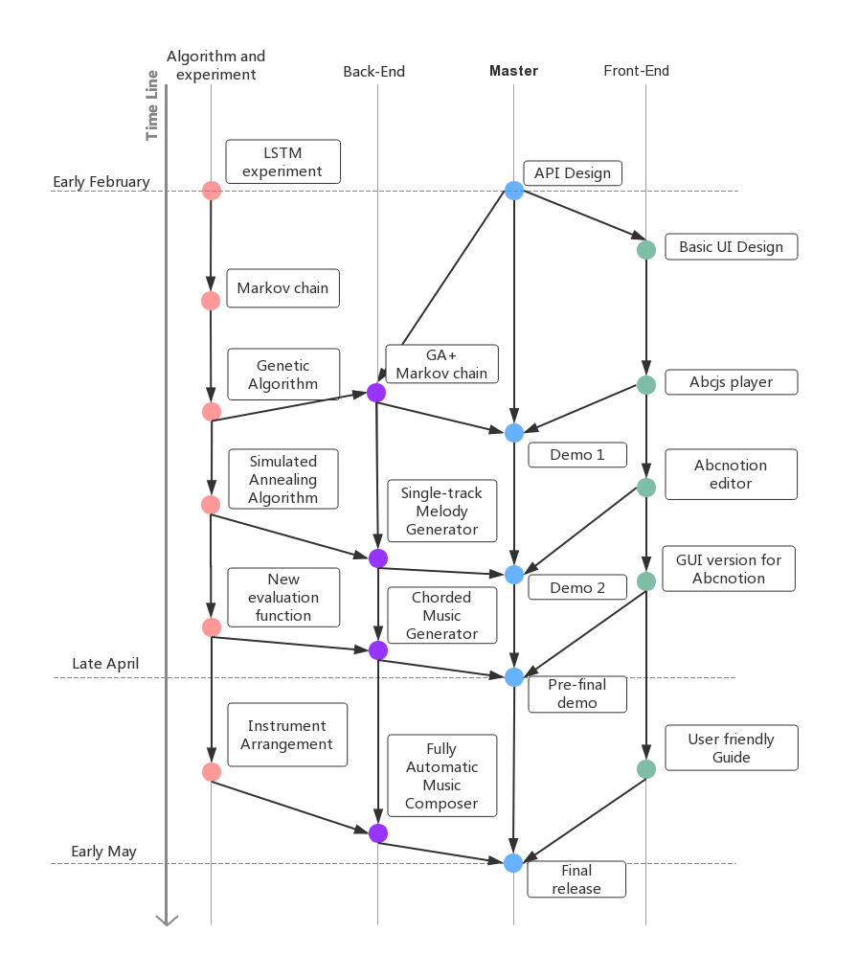
01. Goal & SE Cycle Life
Goal:
Create a fully automatic melody generator on website platform.
Put focus on how to improve the user experience.
Parallel Timeline:
Algorithm and experiment
Backend development
Master program
Frontend development

Slide 8
02
Individual
Contribution

Slide 9
02. Individual Contribution
Li Kengjie:
Main Front-end Development
Documentation
Zhang Ruoqing:
Front-end Design & Development
Documentation
Mo Fan:
Main Back-end Development
Algorithm Design
Wang Junce:
Back-end Development
Api Design
Ye Shuqian:
Back-end Development
Product Manager
Documentation

Slide 10
03
Front-end
Demostration

Slide 11
04
Problems &
Solutions

Slide 12
04. Problems & Solutions
01
P: Different Music Representation Standard
S: Use abc notion standard as interface.
02
P: For the property of genetic algorithm model, last bar ends in established note is not guaranteed.
S: A Pre-defined Gene with Established Ending
03
P: From Single Track to Multiple Tracks
S: A pre-defined dictionary is referenced to generate chord.
04
P: Blocking wait in GUI
S: Asynchronous requests

Slide 13
05
Next 2 Weeks
Plan

Slide 14
05. Next 2 Weeks Plan
Chord & Arrangement
Change the chord generator to a dynamic programming algorithm. Let the program compose not only melody but also instrument arrangement. A novel algorithm must be applied on it. If possible, add velocity performance to output a wav file.
User Guide & Art Style Redesign
Create a user-friendly guide for abc notion. Either the document page or the interactive guide is accepted.
Redesign the art style and adjust the layout. The version demonstrated is not recommended.

Slide 15
Q & A
Thanks all for listening!

